Slide 1

MISIE
David Symon
AC BUČOVICE 4. 12. 2016
FromCzech2016 1

Slide 2

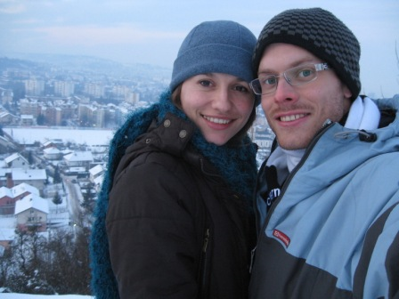
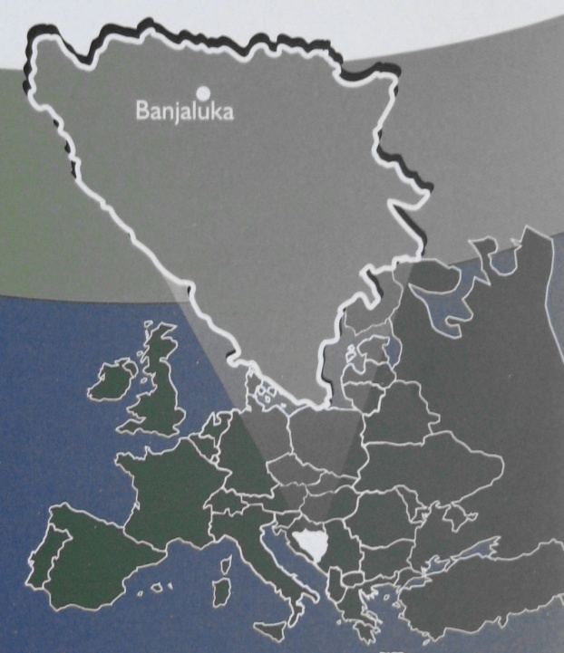
Irena a David Symonovi – misie v Bosně a Hercegovině
FromCzech2016 2

Slide 3


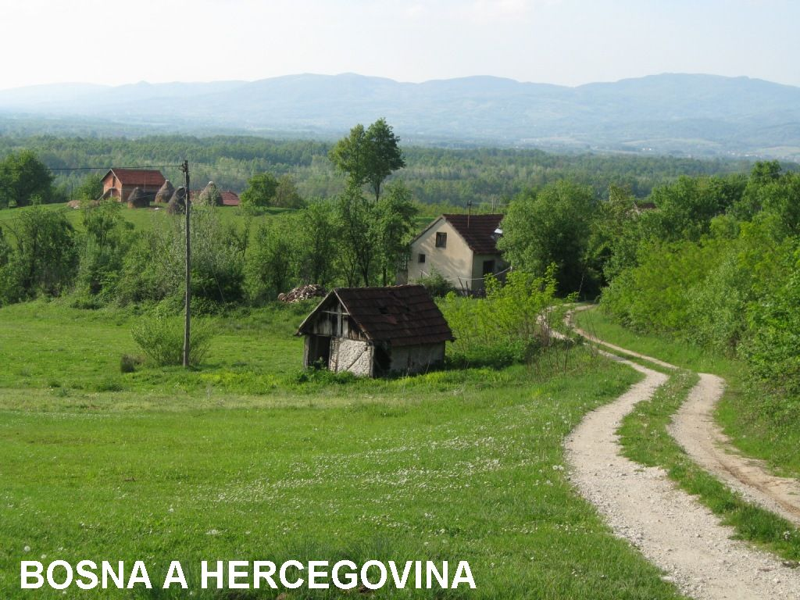

ČESKÁ REPUBLIKA
FromCzech2016 3

Slide 4
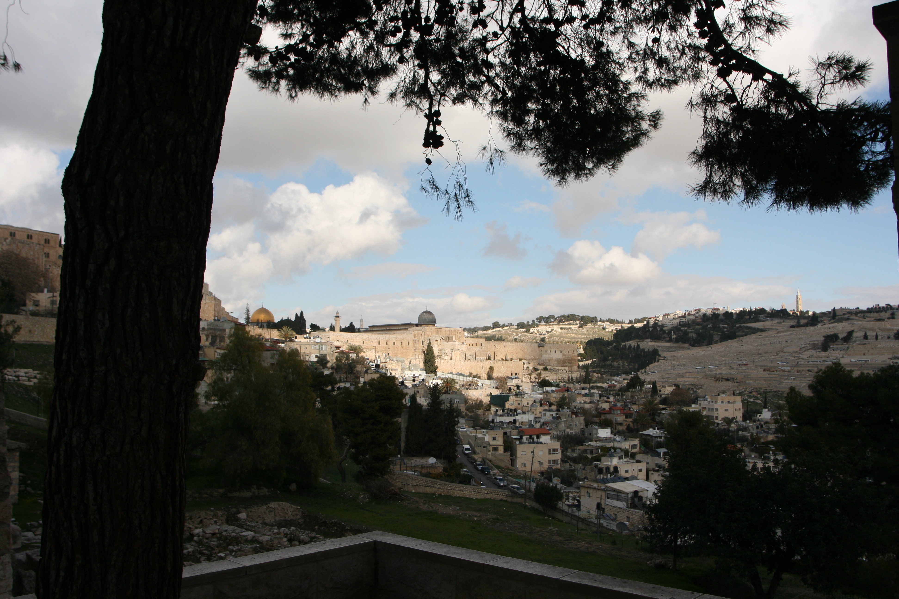

Misie
FromCzech2016 4

Slide 5
Lk 24:13-35
FromCzech2016 5

Slide 6
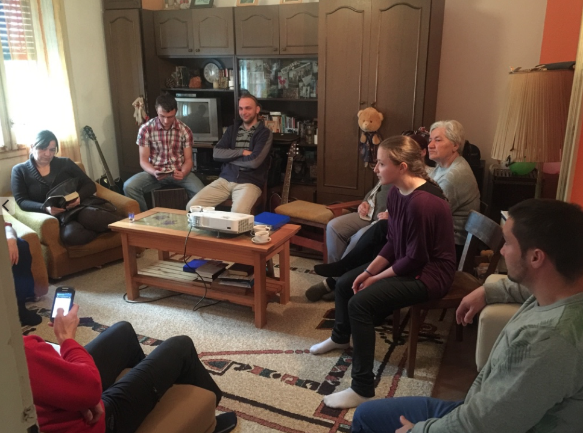
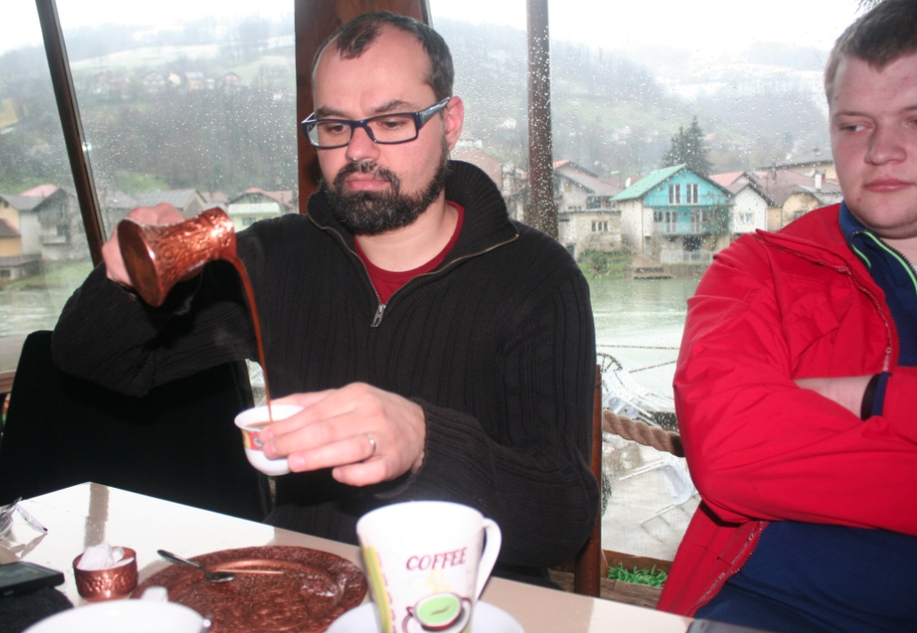
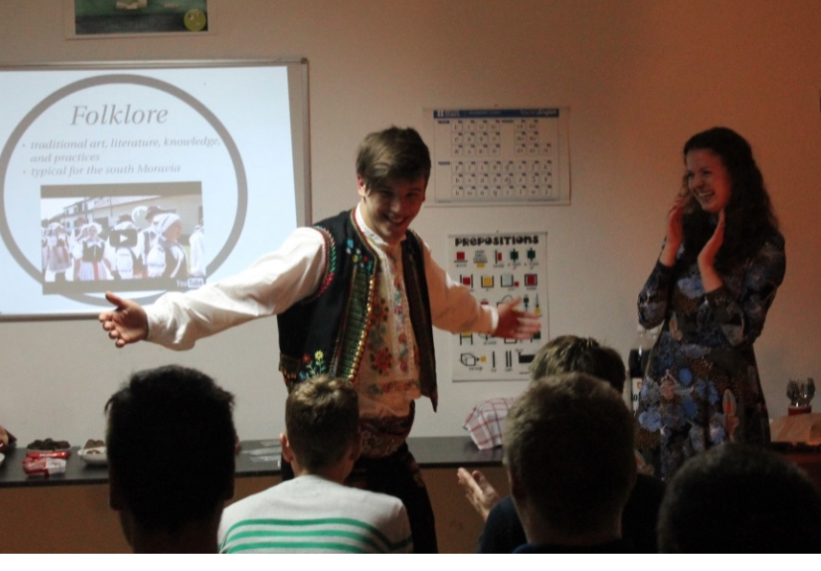
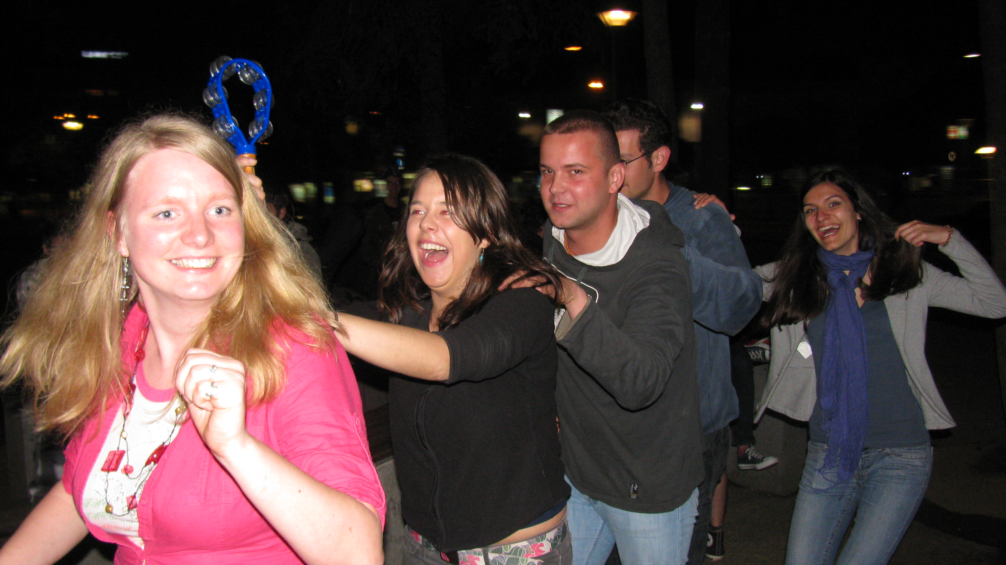
Češi a misie
FromCzech2016 6

Slide 7
FromCzech2016 7

Slide 8
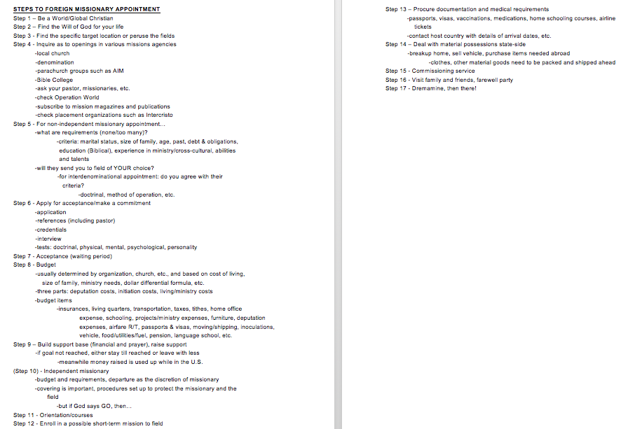
FromCzech2016 8

Slide 9
FromCzech2016 9

Slide 10
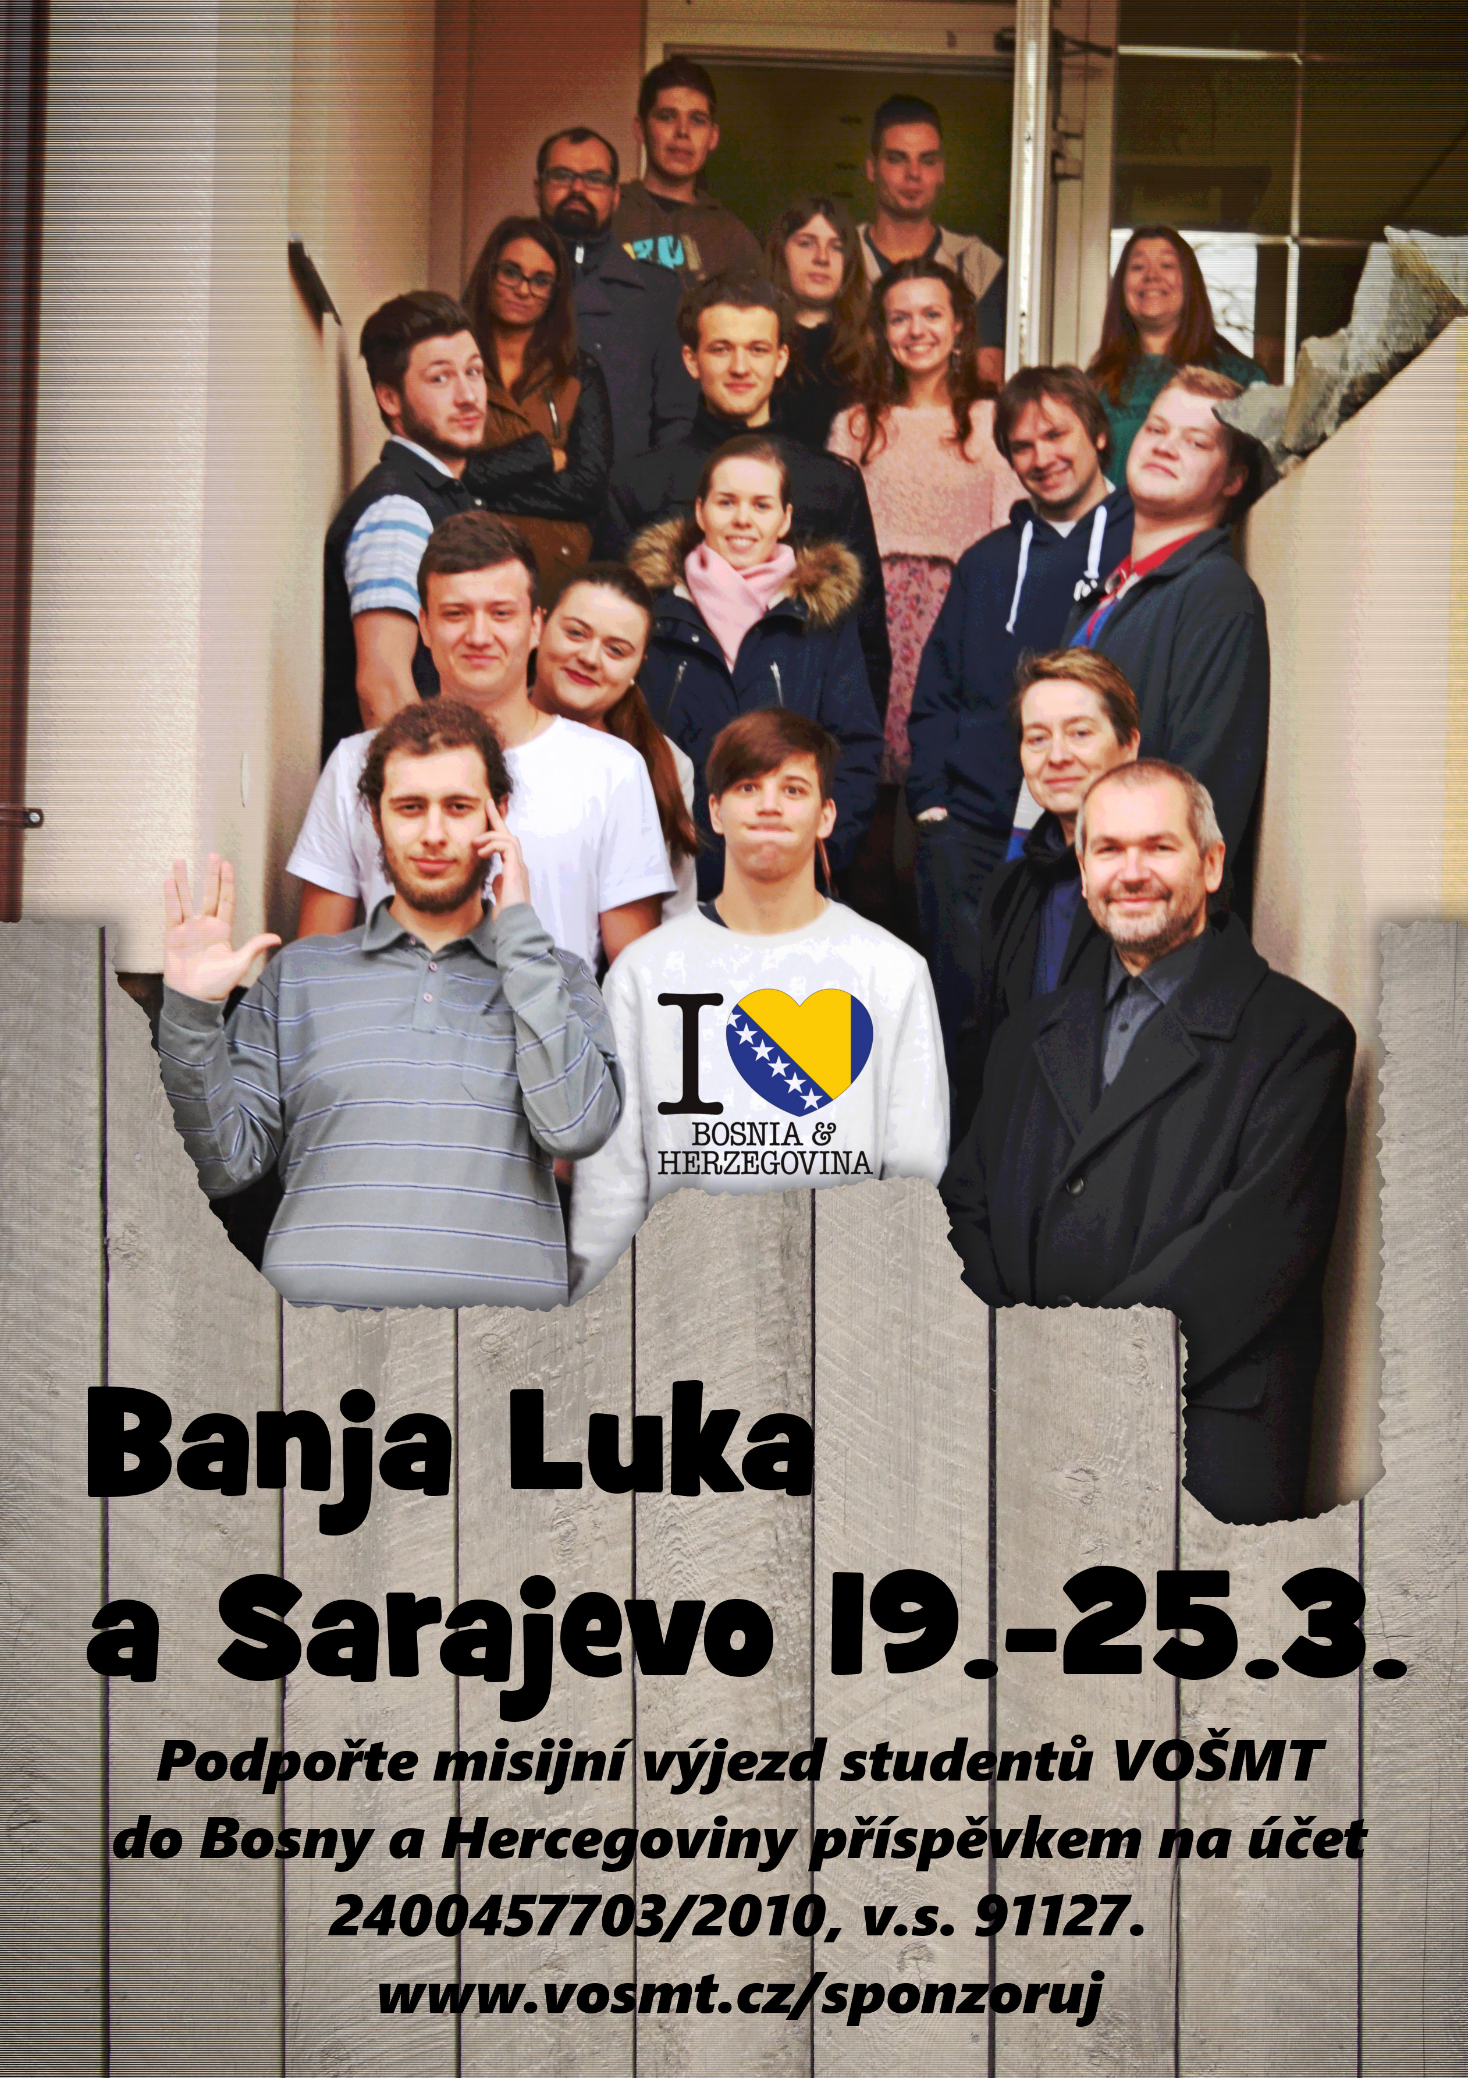
FromCzech2016 10

Slide 11
FromCzech2016 11

Slide 12
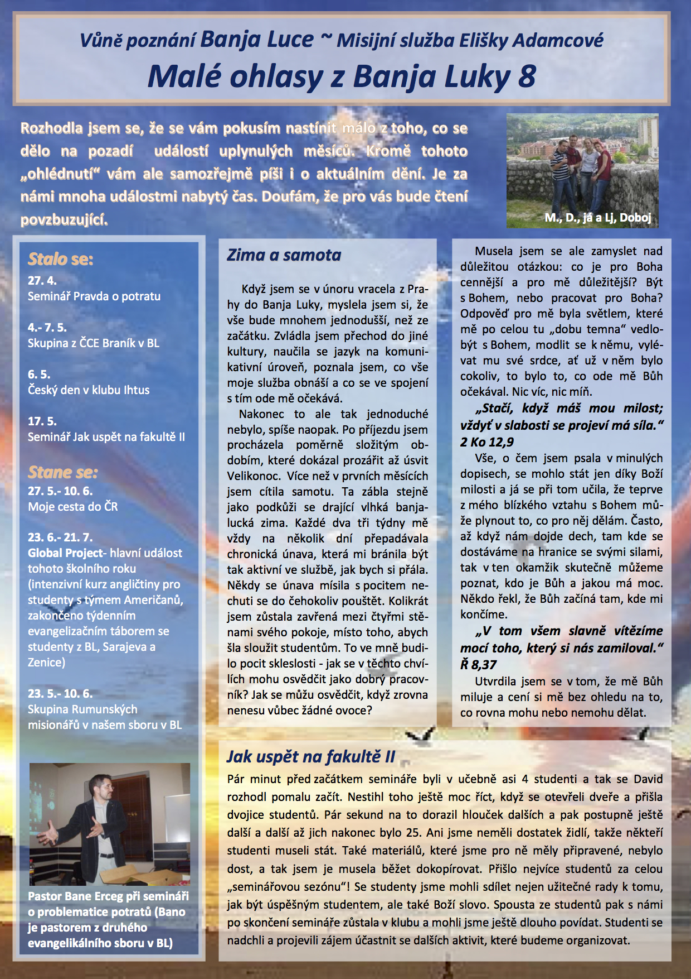
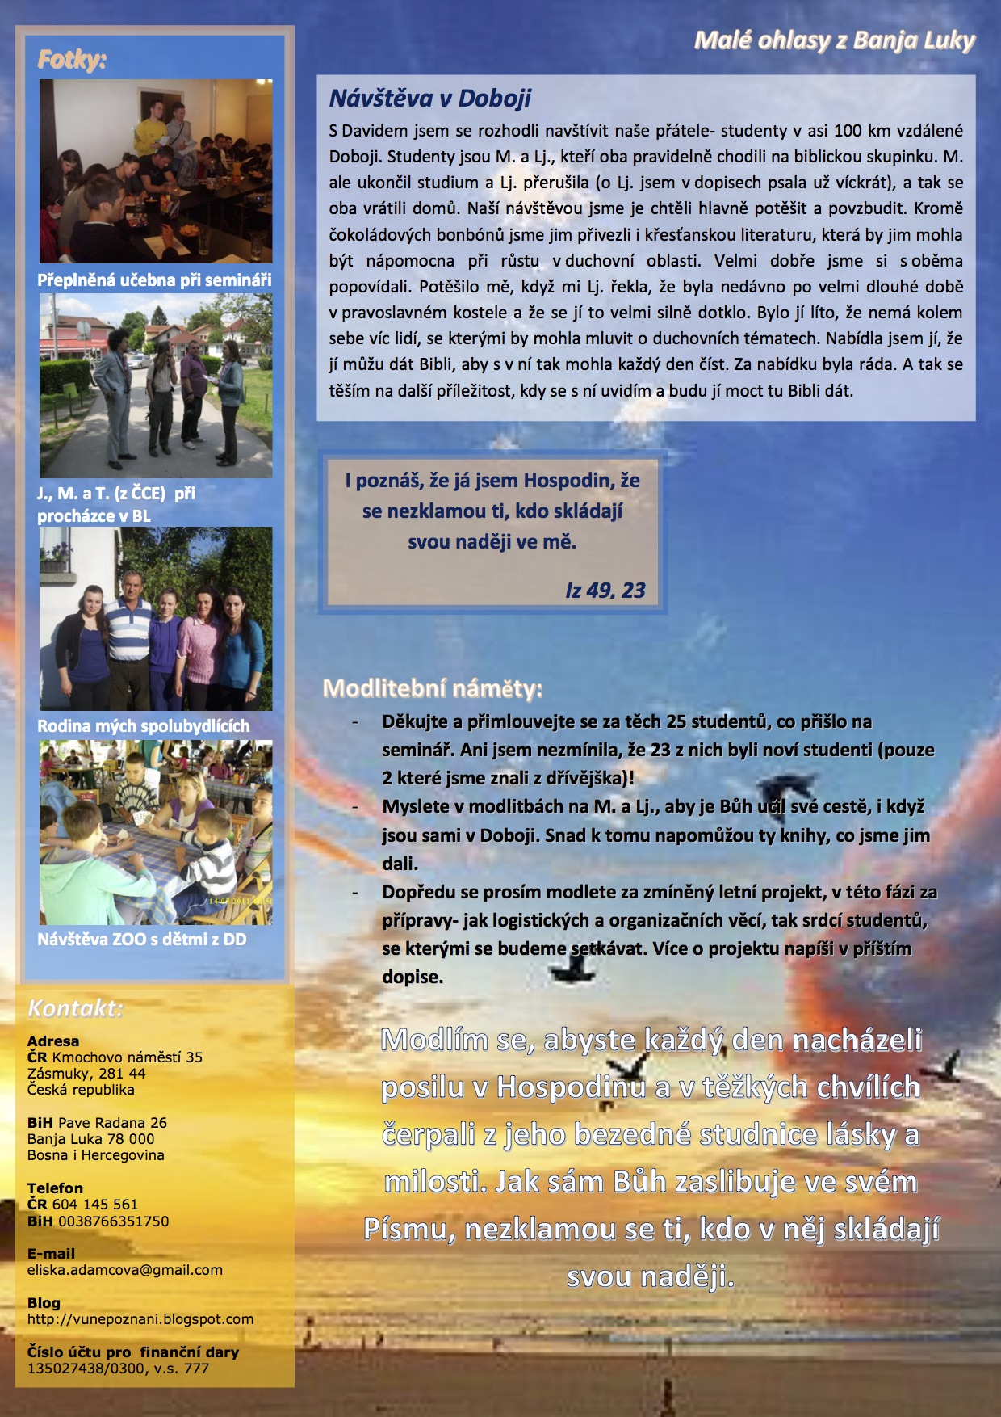
FromCzech2016 12

Slide 13
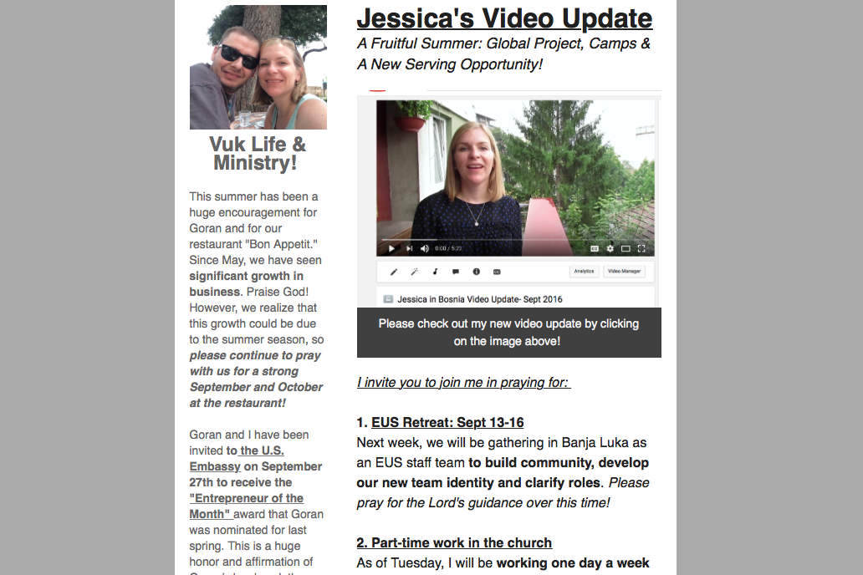
¨
FromCzech2016 13

Slide 14

FromCzech2016 14

Slide 15
FromCzech2016 15

Slide 16

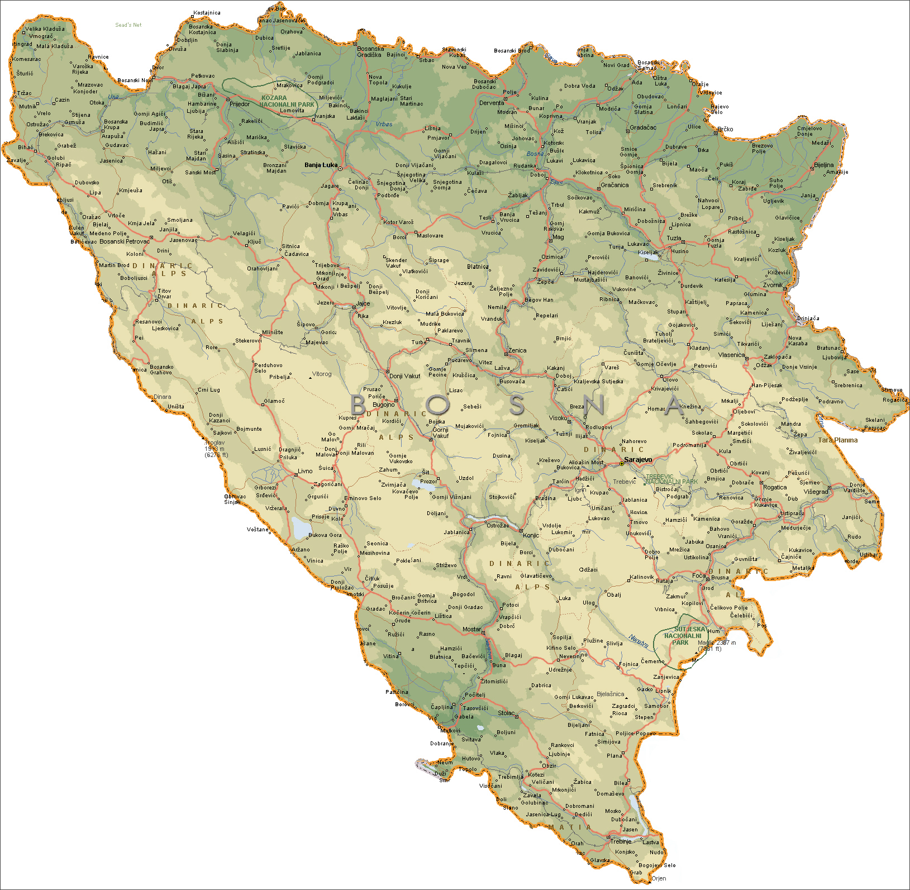
FromCzech2016 16

Slide 17
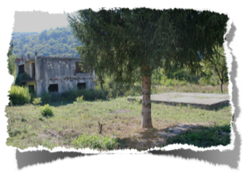
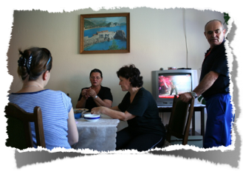

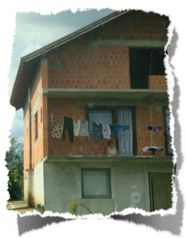

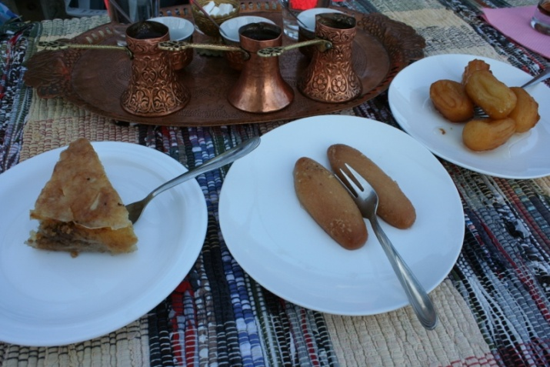
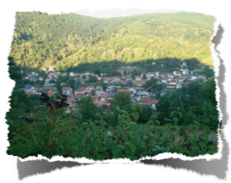
FromCzech2016 17

Slide 18
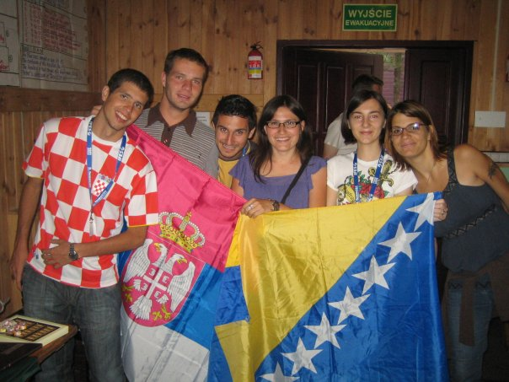


FromCzech2016 18

Slide 19
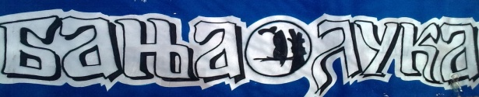

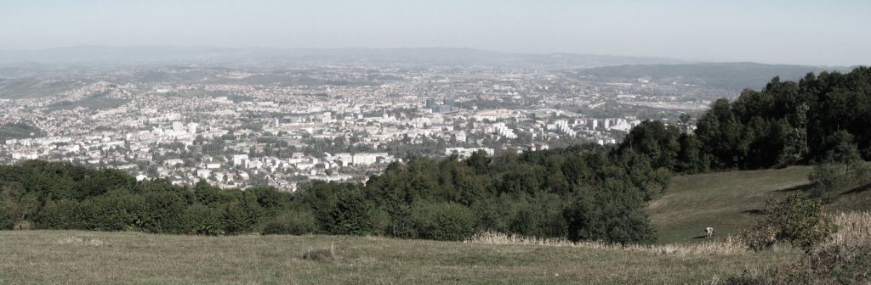
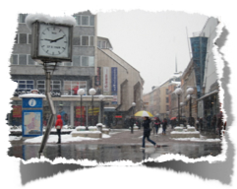
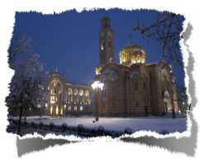
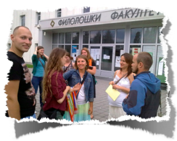
FromCzech2016 19

Slide 20
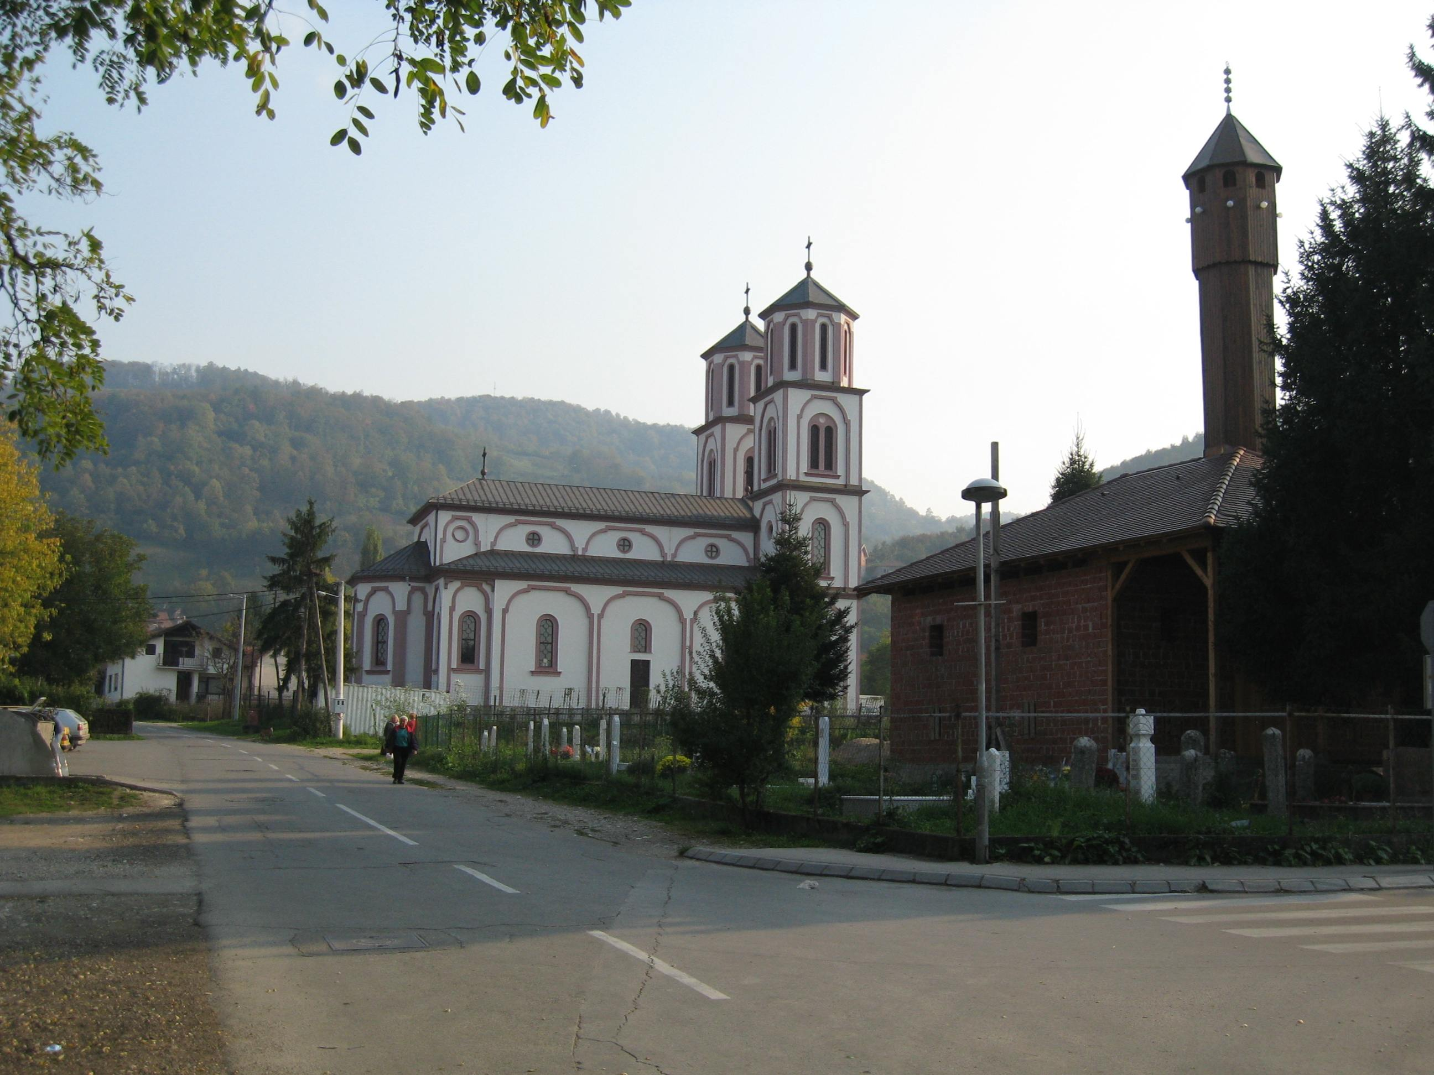
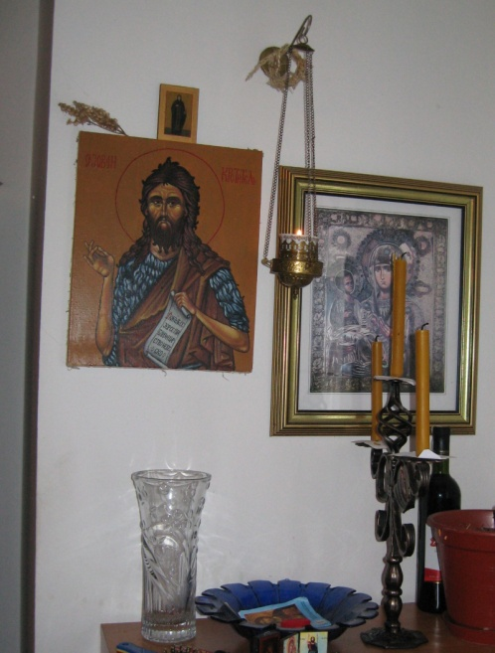
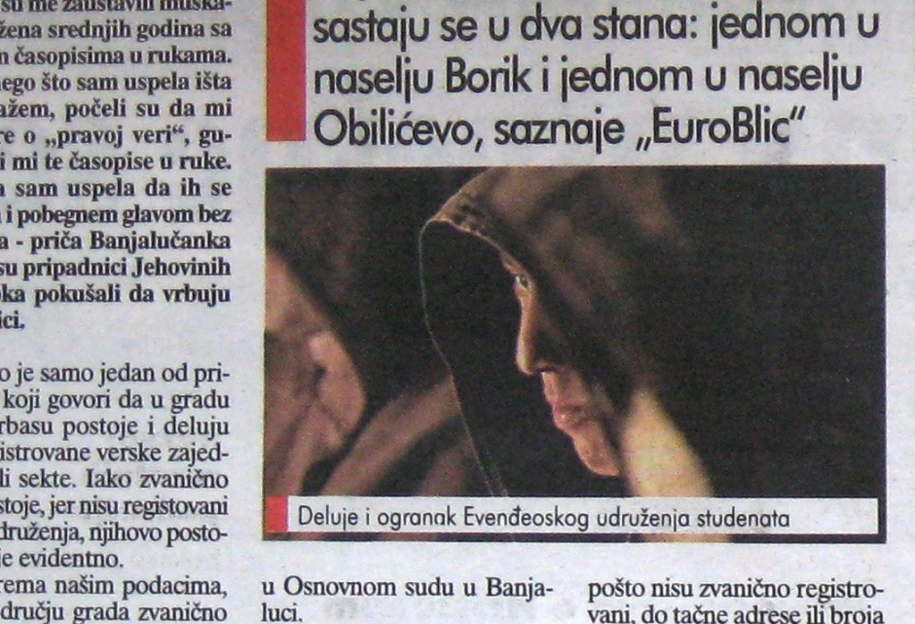
FromCzech2016 20

Slide 21
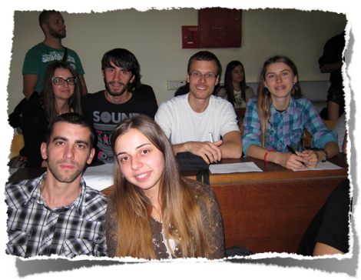
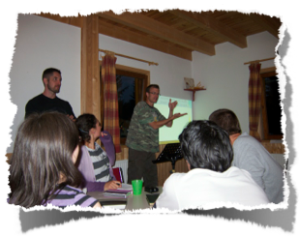
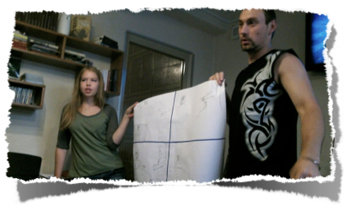
FromCzech2016 21

Slide 22
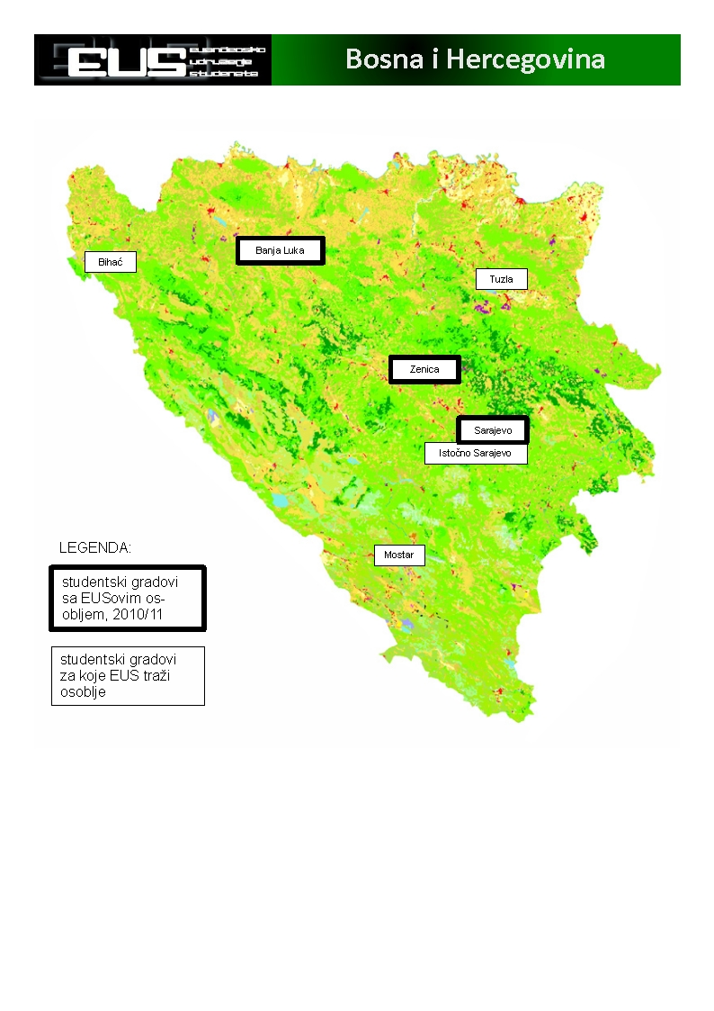
FromCzech2016 22

Slide 23
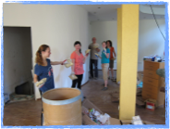
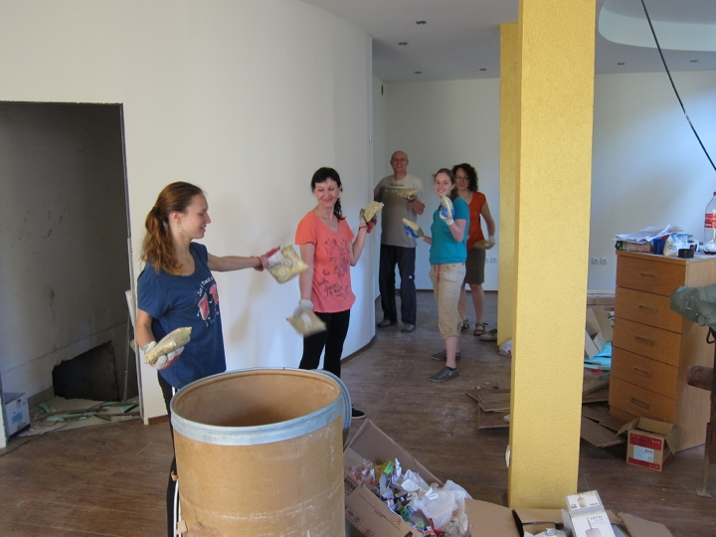
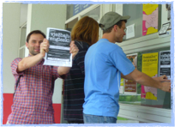
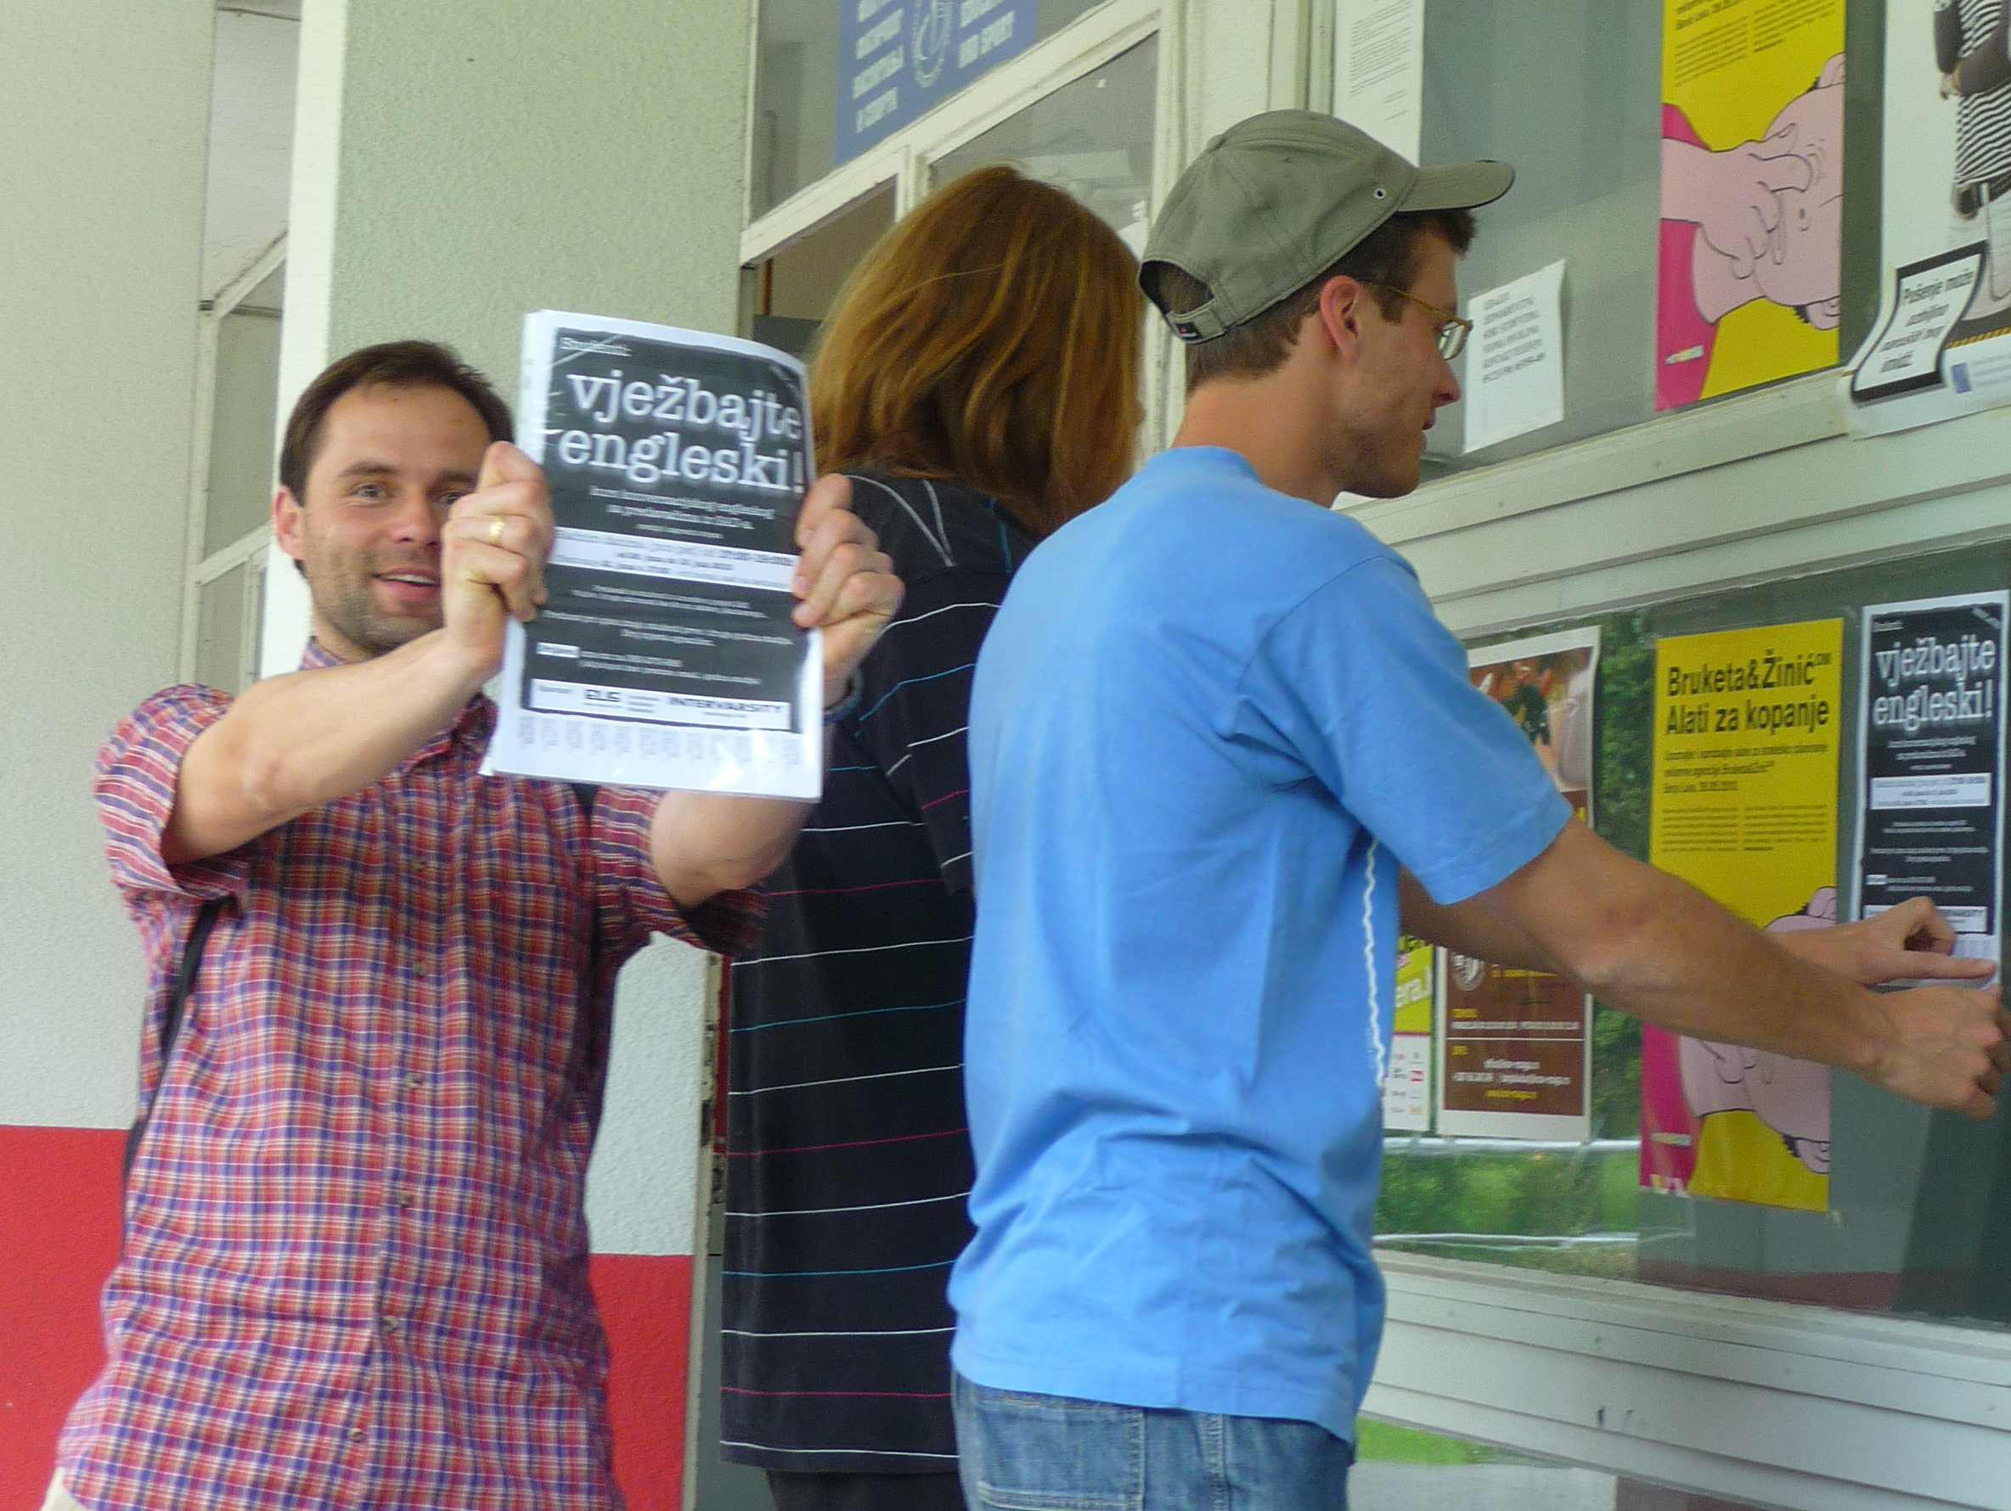

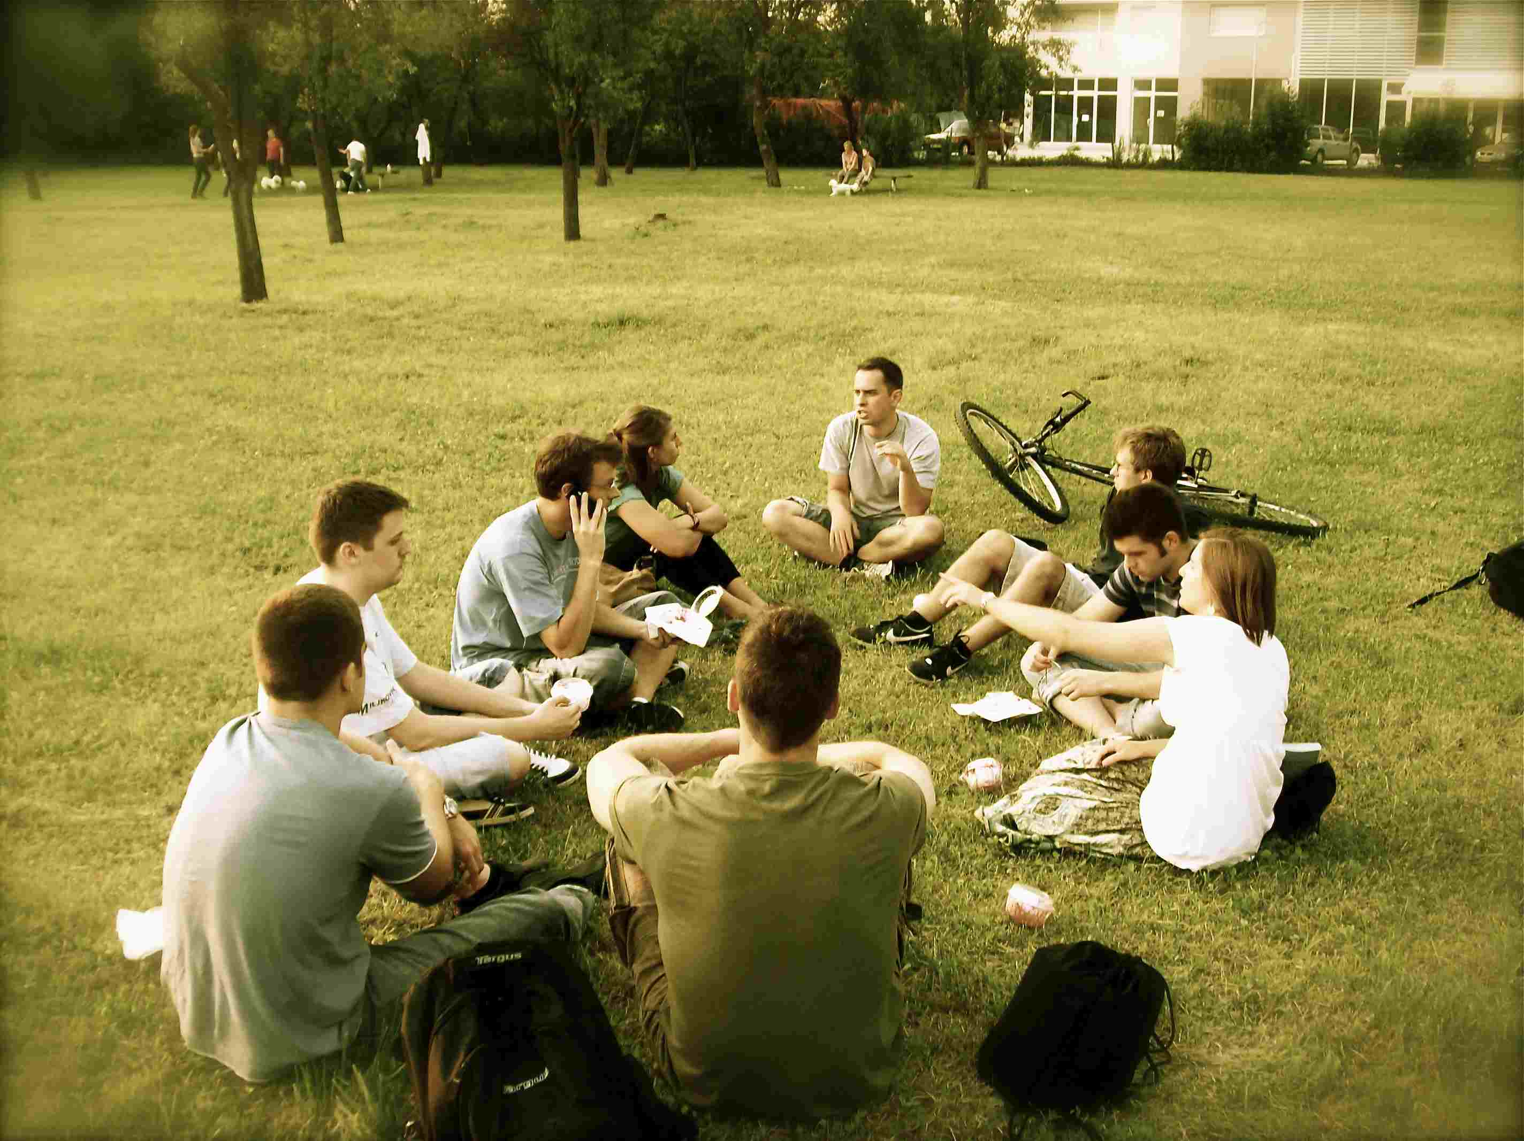
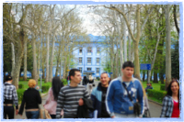
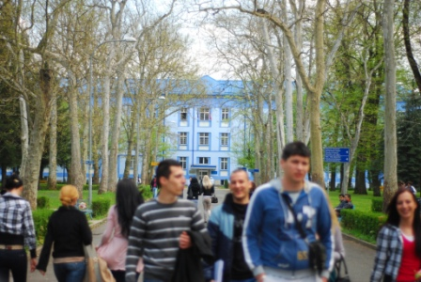
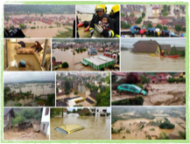
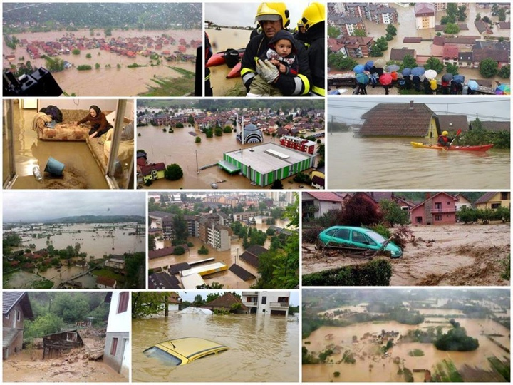
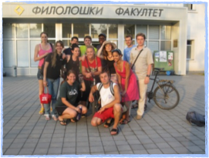
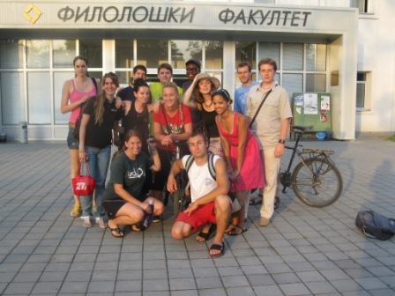
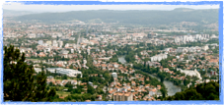
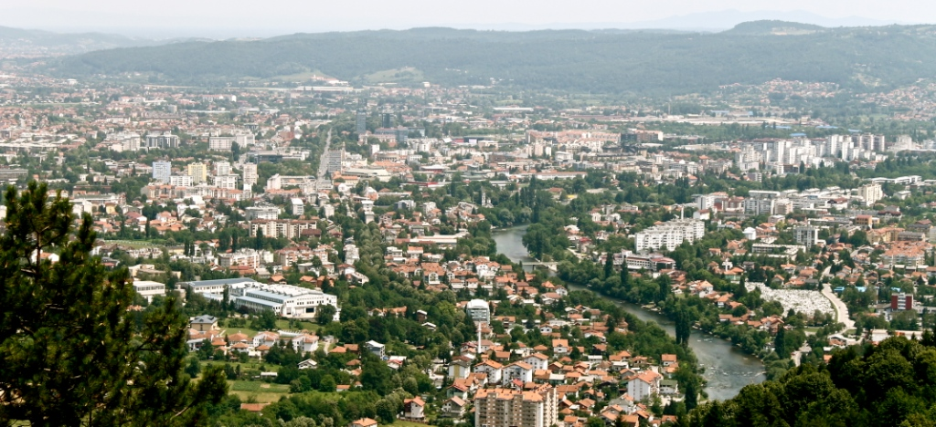
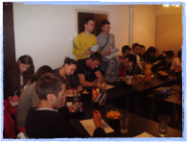
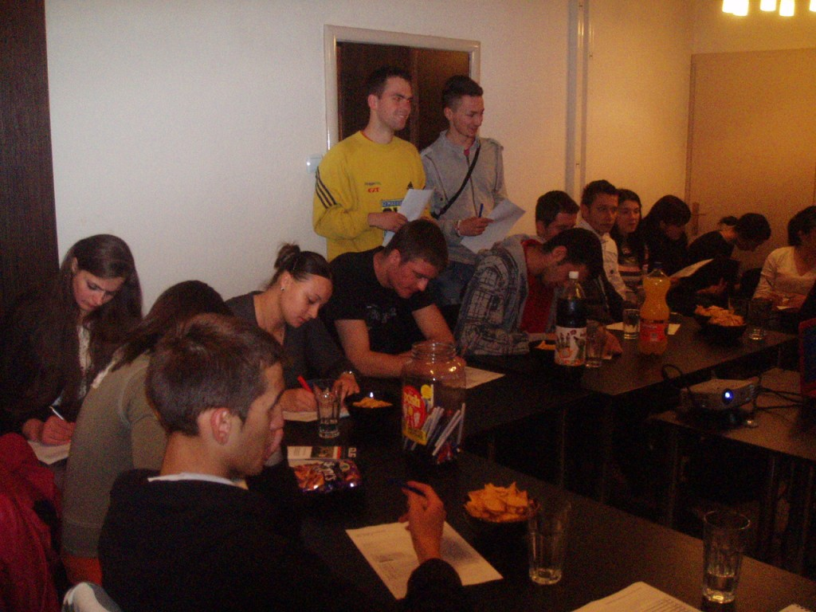
FromCzech2016 23

Slide 24
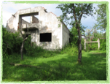
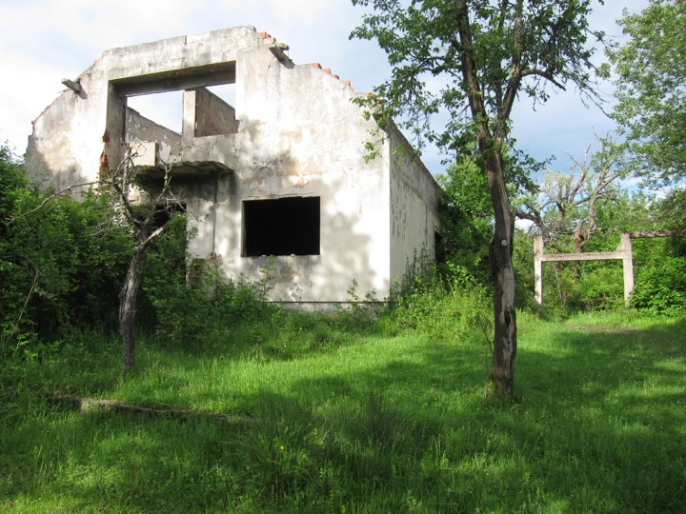
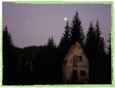









FromCzech2016 24

Slide 25
FromCzech2016 25

Slide 26

FromCzech2016 26

Slide 27

FromCzech2016 27

Slide 28







Tentative Research Question
How have the last 30 years of the Czech experience shaped the mission theology and practice of Czech missionaries in the Balkans?
1. How much of Czech mission theory and practice is imported from outside, especially from western Europe and North America?
2. What theological and missiological motifs and Bible texts are of significance to contemporary Czech mission?
3. How does the church in the Czech Republic (30ys) understand ‘mission’?
4. Which factors in the Czech identity and experience shape their approach to mission?
5. How has been mission carried out between 1989 and 2016 in the Balkan region?
DAVID SYMON Czech contemporary mission, Oxford Centre for Mission Studies, dsymon@ocms.ac.uk
FromCzech2016 28

Slide 29


Contribution to theory & practice
  To help pioneer Czech missiology
  To prepare the ground for further research on the same topic
  To contribute to the discourse on mission theology and practice from the Slavic/Eastern European perspective
  To show the Czech mission practice how to understand its ‘Czechness’ and how to utilize it, while carrying out mission incarnationally and contextually.
  To equip the current and future Czech missionaries in the Balkans
  To make a step towards founding of a Czech Mission Association
DAVID SYMON Czech contemporary mission, Oxford Centre for Mission Studies, dsymon@ocms.ac.uk
FromCzech2016 29

Slide 30


KONTAKT
Irena a David Symonovi
Jiráskova 726, Dobřichovice, 252 29
david_symoncz@yahoo.ca
736 22 88 77
FromCzech2016 30

